Slide 1
Revenue Forecasting & Price Sensitivity
How revenue responds to demand, pricing, and network growth and what a price change would do to income

Slide 2
The Question
How does revenue move with demand?
Revenue is price * energy, so the first job is separating what drives energy delivered
Do customers respond to price?
If they do, a price rise could cost more is lost demand that it earns. If not, price is a free lever.
What would +-5% and +-qo% do in 2025?
Forecast a 2022 baseline, then stimulate both price changes under a range of customer sensitivities.

Slide 3
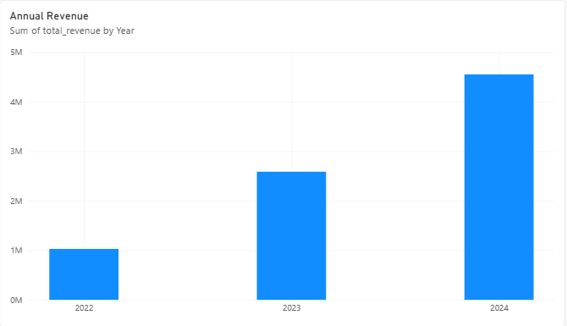
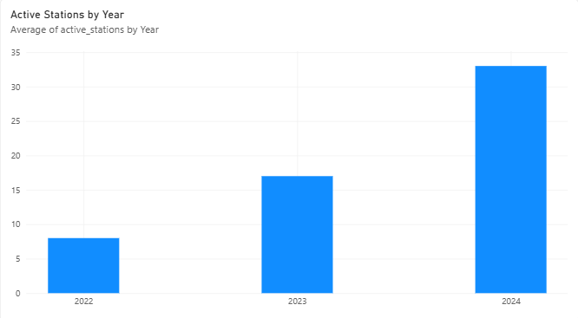
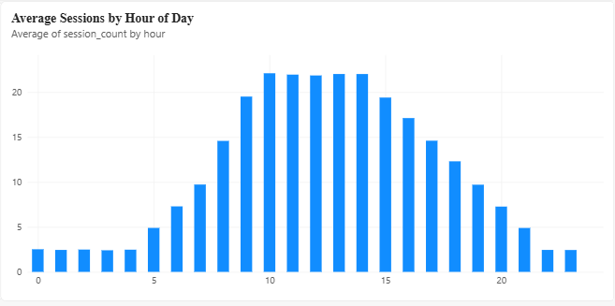
Revenue Grew With the Network
Revenue grew about 4.4x in two years while the network grew about 4.1x. Total revenue mixes network size with customer behaviour, so everything that follows is measured per station

Slide 4
Price Moved and Demand Per Station Did Not
Year | Avg Price (£/kWh) | Sessions per station-day | kWh per station-day | Arc elasticity
2022 | 0.511 | 13.92 | 689.0 | -
2023 | 0.639 (+25%) | 13.88 | 652.6 | -0.21
2024 | 0.588 (-8%) | 13.85 | 641.5 | +0.21
Price rose 25% in 2023 and fell 8% in 2024, yet sessions per station-day barely moved (13.92 to 13.88 to 13.85).
The two elasticity estimates have opposite signs (-0.21 and +0.21), so they are not a consistent response, the estimate is effectively zero.
At session level, price variation left after removing year and peak-hour effects has a correlation of -0.0016 with energy per session.
Caveat: only three price levels exist and the data looks simulated, so a measured zero may reflect how it was generated.

Slide 5
The Forecast Model
Prophet, fitted to daily kWh station, Revenue = station +kWh per station-day * price
3.8%
Daily MAPE on a held-out 90 days
30.4
RMSE in kWh per station-day (about 5% of the typical level)
1006/90
Training days/ test days, all test days at 33 stations
Only demand is modelled. Stations and price are explicit assumptions, so the model does not extrapolate network expansion or price steps as a trend.
Strong weekly patterns run about 27% below weekdays. No reliable yearly seasonality, the model with and without it scored the same (RMSE 30.76 vs 30.41), so the simpler one was kept.
Limitation: over the Oct-Dec test window the chosen model runs slightly low (under 2% per month). The window cannot speak to other months.

Slide 6
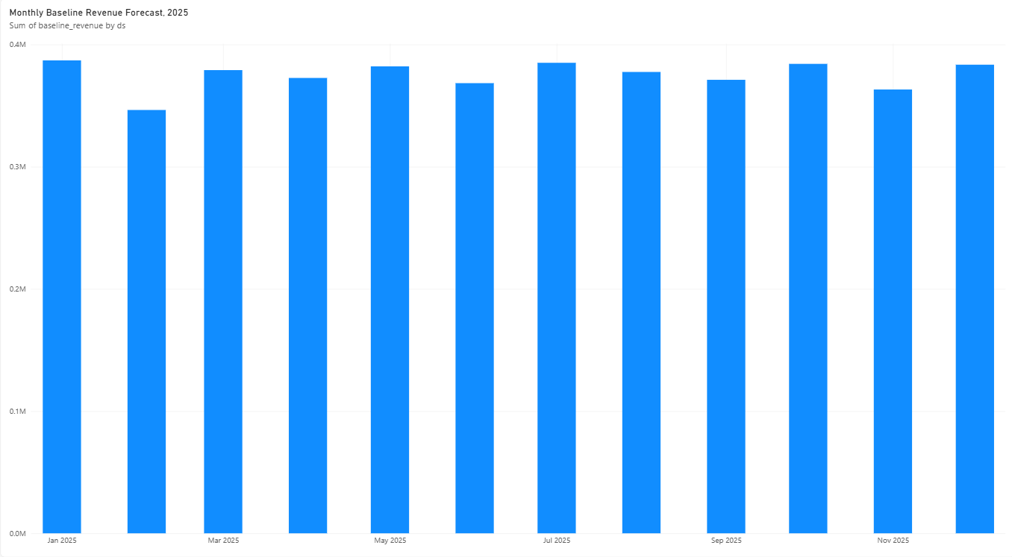
2025 Baseline Revenue Forecast
Monthly baseline revenue, 2025 (£k)
£4.50M
2025 baseline total
-1.2% vs 2024 (£4.55M)
Assume 33 stations and the 2024 average price of £0.558/kWh, with per-station demand continuing its gentle decline.
Monthly differences reflect days in the month and weekend count, not yearly seasonality
About 0.3 points of the 2025 vs 2024 gap come from 2025 having one fewer day.

Slide 7
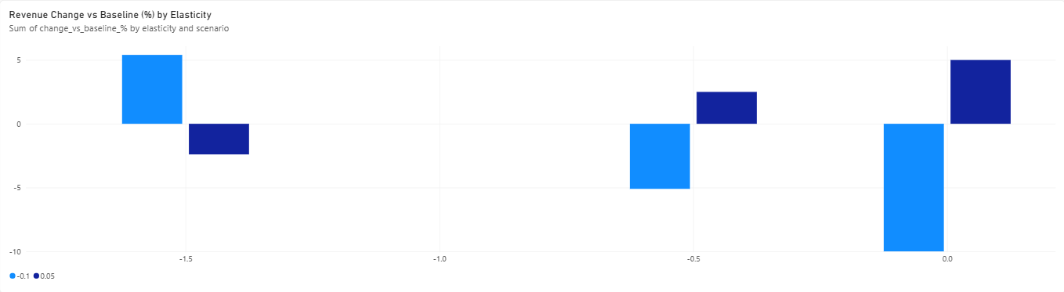
Price Scenario: +5% and -10%
Change in 2025 revenue vs baseline, under different assumed customer sensitivities (elasticity ε)
Break-even: ε = -1
At zero elasticity (the measured value). +5% adds £225 (£4.73M) and -10% loses £450k (£4.05M).
If customers are more price-sensitive than -1, the effect flips: a rise loses money and a cut gains.
This data cannot say which side real customers are on.

Slide 8
Pricing Impact and Recommendations
Treat the price evidence as thin
At the measured elasticity, +5% adds 5.0% revenue, but break-even is ε=-1 and three price levels cannot rule out more sensitive customers.
Pilot before rolling out
Test a +5% change at a subset of stations and track per-station demand, so real behaviour replaces an assumed elasticity.
Network growth is the bigger lever
Each station earns about £136k a year at baseline, a 5% price rise at zero elasticity is worth roughly 1.65 stations.
Revisit the forecast assumption
The baseline holds 33 stations and the 2024 price, and the dataset appears simulated, update both with real data before relying on the figures.

